Slide 1
National Financial Partners Business Review
May 2013 – Oct 2013

Slide 2
Agenda
NFP Business Update
ADITI’s Business Update
Relationship Overview
Team
Projects
Road Ahead

Slide 3
NFP Business Update

Slide 4












ADITI Business Update
2012 Partner of the year
Windows Azure , Finalist
2011 Partner of the year
Windows Azure SI, Finalist
2010 Partner of the year
Windows Azure , Winner
52% of our customers rate us 5/5.
75 + active customers.
1200+ engagements.
1400 people, globally
18 years, 12 locations
Voted GPTW – thrice in 5 years
7th best IT Workplace in India
Global Cloud MVPs
Top 50 Cloud influencers
1:114 hiring ratio
The Best ‘OF’ Vendor Award

Slide 5
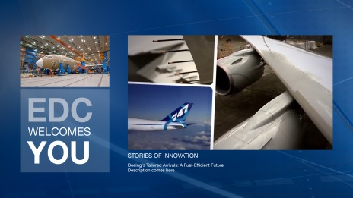
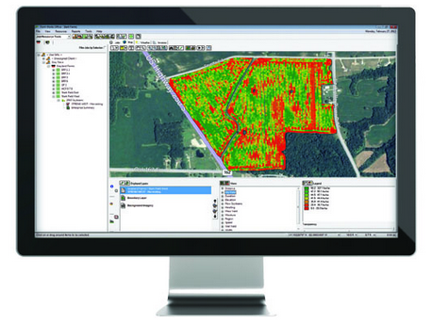
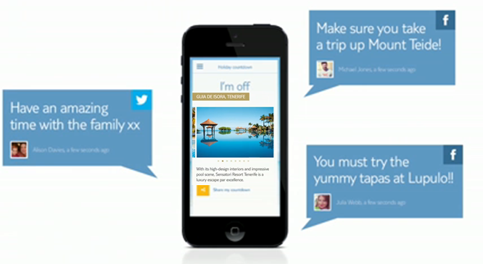
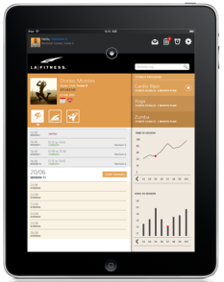
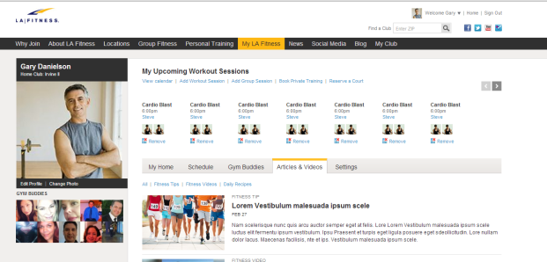
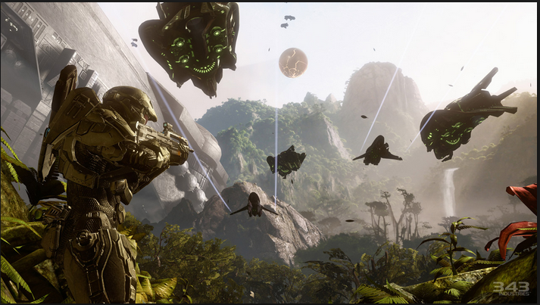
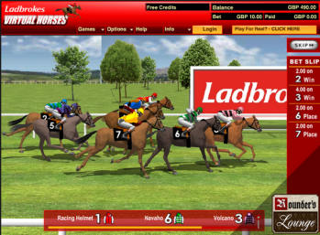

WE HELP OUR CUSTOMERS deliver experiences for theirs
HOW DO YOU SELL A PLANE ?
HOW DO YOU CONNECT CORN TO THE CLOUD
HOW DO YOU TAKE STRESS OUT OF HOLIDAY PLANNING ?
HELPING BOEING REDESIGN CUSTOMER EXPEREINCE IN ‘INTERACT AND BUY A PLANE’ BRIEFING CENTER.
185
MILLION USD
AVG SKU PRICE
HELPING WORLD’S LEADING AGRI- PRODUCT DISTRIBUTOR LEVERAGE SATELLITE IMAGING, DEVICES, CLOUD & ANALYTICS IN 1 RELEASE
9
MONTHS
TO GO LIVE
HELPING EUROPE’S TOP TRAVEL COMPANY DRIVE CUSTOMER ENGAGEMENT AND LOYALTY WITH A BLOCKBUSTER APP LAUNCH
TOP
APP IN TRAVEL CATEGORY
3
MONTHS
TO DELIVER
Mobile + Cloud + Really Big Data
2 MONTHS TO MOBILE STRATEGY
HOW DO YOU MAKE A GYM MORE STICKY ?
HOW DO KEEP 3 MILLION GAMERS GUESSING ?
HOW DO YOU NOT LOSE MONEY ON HORSES?
HELPING AMERICA’S #1 FITNESS CHAIN REACH MORE CUSTOMERS AND DRIVE MORE LOYALTY WITH MULTICHANNEL ENGAGEMENT
HELPING HALO TEAM ANALYZE INTERACTION DATA AND ALTER GAME ENGINE REAL-TIME TO KEEP PRO-PLAYERS COMING BACK FOR MORE
#1
LARGEST AZURE INSTANCE
IN THE WORLD
HELPING LADBROKES IMPROVE GAME MARGINS BY 4% POINTS BY EXPANDING CHANNELS AND LOWERING DOWNTIME
4
YEARS OF CO-ENGINEERING
3
CHANNELS
WEB, SOCIAL,
MOBILE
3
MILLION
PLAYERS
120
PEOPLE IN 9 MONTHS

Slide 6
Relationship Overview
Project Dashboard
Data Team
Overall 13.1 release – good contribution
QA Team
Test Automation – CI integration
UTP Team
Drive the look and feel, flow of UTP
Principal Dashboard
Design ownership for modules
191+ Support tickets
13.1-A release : 432 defects, 13.1-C release: 60 defects
Bi-weekly deployments & overnight jobs
Quick turnaround on prototypes iterations
Outstanding quality, minimal defects
AppFabric Admin tool
Leveraged onsite\offshore model
Data jobs support from offshore
Cutting edge technologies
Data Testing for first time, good defects

Slide 7
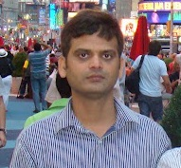





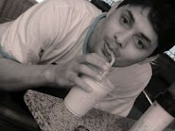
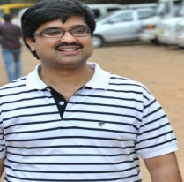




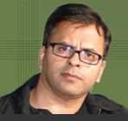
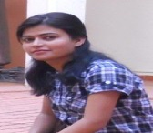

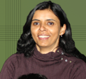
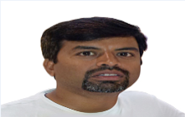
Team
Rajesh
Team Statistics
Size | 13
Onsite: Offshore Ratio | 2:11
Avg yrs of experience | ~8 years
3+ years of Aditi-NFP partnership!
Rohit
Nilesh
Vaishnoo
Vinuthan
Karthik
Gopi
Anil
Manu
Jagdish
Arun
Rajeshwari
Neena
Energy
Team
Synergy
3+ years partnership - continued collaboration
Best in class talent
Highly motivated and passionate about technology
Good rapport with stakeholders
Willing to stretch when needed
Onsite travel - great opportunity for Manu, Vaishnoo
Improved domain knowledge
Zeal
Babushekar

Slide 8

Data Team
Rajesh
Vinuthan
Jagdish
Product Deliverables | Release Date | Met Scheduled Date
BI Development | August, 2013 | Yes
Data Support jobs, tickets | Ongoing | Yes
Major Tasks
13.1 Release and Demo environment setup for 13.1
Asset Transactions and Historical Asset
Performance, Reports and Fusion Changes
Support: Working on production tickets, Daily jobs
Sponsor Equivalence* and 5 New Reports
L&A Life Feed Processing
Data Maintenance Framework and Utility*
Data Tickets
* - In progress
Accolades – Bill Weaver
Guys, thanks so much for tracking this down and getting it fixed! Excellent work and I’m so proud of how you guys work as a team to resolve issues like this.
What went well
Overall 13.1 Release, Performance Related Fixes
Jagdish, Rajesh, Vinuthan: Great working with Bill

Slide 9

QA Team
Vaishnoo
Anil
Rajeshwari
Gopi Chand
Some Support Tickets | Release Date | Met Scheduled Date
13.1 A,B, C releases | Aug, Sep, Oct, 2013 | Yes
10/17 release | Oct, 2013 | Yes
10/30 release | Oct,2013 | Yes
Task Name
13.1 C release: Automation of Rep Maintenance & Automation of Entity Relationship, Testing of Account Establishment Client Details, Entity Relationship, Client Letters, Client Search, Edit Client, Cube Validation & Compensation Statement Testing, CLP changes, Client Search,CDM, initiated from 13.1C release and has been completed well during Dev QA &UAT .
10/17 release; 10/30 release: Completed 13.1 immediate releases on 17th & 30th October for CLP Changes & Work Queue UI changes. UTP : Third round of Prototype testing on UTP completed.
Accolades – From NFP Onsite
Thank you all, especially to Anil,Gopi for 10/30 release. -Jane Awesome! Thanks all!!! Appreciate all your efforts – Jane Thanks for all your contribution to UTP – Sandhiya
What went well
Vaishnoo, Anil, Rajeshwari, Gopi: Involved in13.1C release with Jane to track & test issues found during 13.1 A release. Rajeshwari : UTP Prototype testing completed. Anil: Completed 13.1A Dashboard. Updated with new App pages in Bi-Weekly Node Testing. Test run on the existing scripts.
Slide 9

Slide 10

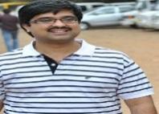
UTP Team
Nilesh
Manu
Arun
Babushekar
Karthik
Product Deliverables | Build Type | Release Date | Met Scheduled Date
Visual Designs for UI | N/A | OCT-2013 | Yes
Prototypes | N/A | Ongoing | Yes
Major Tasks
UI Revamp for the Usability Study - III
Separate production quality work on Header/Footer service project
Improvement in UTP prototype for Usability Studies - I & II
Started working on CMS Prototype, Implementing Enterprise Search on different DB (NoSQL) platform
Accolades – From NFP Onsite
These look really nice. I’m excited, looks like this is really coming together now. Great job everyone. – Kevin Rivers “This is to give you guys a quick update on UTP, we had our first big demo to the business yesterday. I have got good feedback on the UI concept. Would like to appreciate all the effort “ ……. making the UI and UI components sharp and presentable.” - JP
What went well
Use of TFS for Bugs/Tasks tracking in Usability study-III
Turn-around time for features requested was good
Manu travelled to onsite and co-ordination was good for Usability Study - III development
Started to implement process even if it was prototype development
Arun, Babushekar, Manu, Nilesh, Karthik: Pleasure working with JP, Kevin on the UTP Project
Slide 10

Slide 11
Principal Dashboard
Karthik
Product Deliverables | Release Date | Met Scheduled Date
1. Principal dashboard | Aug, 2013 | Yes
2. AppFabric Admin tool | Aug, 2013 | Yes
3. Optimizing indexing in enterprise search |  | Yes
Major Tasks
Enhancements/modifications to existing dashboard functionality
Integrate Advisor Review to Dashboard
Dashboard KBM bug fixes
AppFabric Admin Tool, Optimizing Client and Account entity indexing in NFP Enterprise search
Accolades – Kevin Rivers
Just wanted to take a moment to say thanks and great job guys! The Dashboard, Alerts, Address Standardization, Enterprise Search, and Client Service are all sitting at a defect count of 0. All known bugs of any status, mediums and lows included, have been resolved. And the AdvisorComplete menu is sitting at 1 medium that’s merely waiting on a deployment to be closed out.
What went well
Working on AppFabric admin tool and Enterprise search were interesting.
Karthik: It is a pleasure working with Kevin.
Slide 11

Slide 12
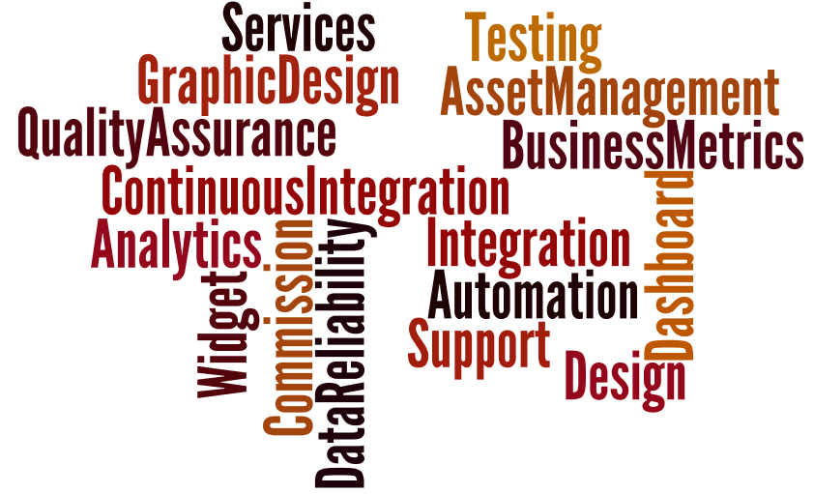
Value Adds

Slide 13
Road Ahead…
Vision and project roadmap for 2014
Projects in Insurance/Benefits
UTP: Team plan and next steps
QA Team: upcoming releases, Continuous Integration
Data team: Rajesh’s aspirations for onsite travel
Agenda for visit to Aditi Bangalore office:
Meet offshore team
Process Excellence team, Agile
Aditi Cloud capabilities
SalesForce discussion
Analytics/ Big data
Support/Managed services capabilities

Slide 15
Team Composition
Notes:
Move to the end…

